Slide 1


HECTORVILLE SPORTS & COMMUNITY CLUB
Welcome to the HSCC Induction

Slide 2
HECTORVILLE SPORTS & COMMUNITY CLUB
Agenda
Brief on the changes
Employee Details Form
Tax Forms
Superannuation Forms
What is expected
Job Descriptions
Rosters
Time Sheets
Dress Code
Fire Wardens
Club Policies and Code of Conduct
Familiarisation Plan

Slide 3
HECTORVILLE SPORTS & COMMUNITY CLUB
CHANGES
  Brief on the changes
      We are not only a club but we need to be also a business and we need to get That balance right.
      We need now to comply with government laws and regulations
      We now have a structure and a vision going forward and you are a part of this build.
      The structure.

Slide 4
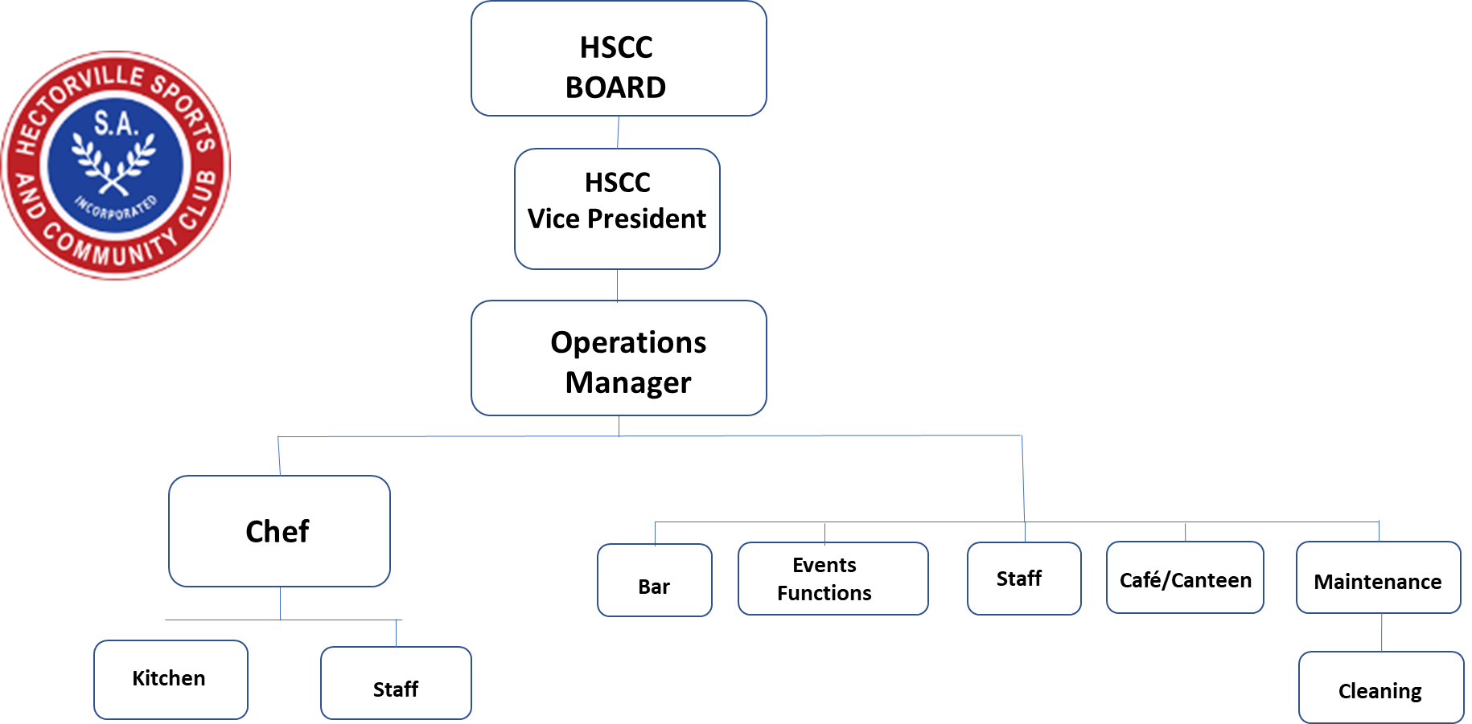
HECTORVILLE SPORTS & COMMUNITY CLUB

Slide 5
HECTORVILLE SPORTS & COMMUNITY CLUB
MUST HAVE
  Employee Details Form
  Tax Forms
  Superannuation Forms

Slide 6
  Employee Details Form

Slide 7
HECTORVILLE SPORTS & COMMUNITY CLUB
  Tax Forms

Slide 8
HECTORVILLE SPORTS & COMMUNITY CLUB
  Superannuation Forms
If you have a Superannuation Fund and you are over 18 we need details as we pay 10% to your fund quarterly.

Slide 9
EXPECTATIONS
  What is expected (Hand out)

Slide 10
HECTORVILLE SPORTS & COMMUNITY CLUB
  Job Description for each work station

Slide 11
HECTORVILLE SPORTS & COMMUNITY CLUB
Rosters
 |  | STEAK DAY | BURGER DAY | SCHNITZEL DAY | HAPPY HOUR
 |  | HAPPY HOUR 5-6. | HAPPY HOUR 5-6. | HAPPY HOUR 5-6. | 5-6.
EMPLOYEE NAME | MONDAY | TUESDAY | WEDNESDAY | THURSDAY | FRIDAY | SATURDAY | SUNDAY
 | 12/7/21 | 13/7/21 | 14/7/21 | 15/7/21 | 16/7/21 | 17/7/21 | 18/7/21
DUTY MANAGERS
Bill Leo | ADMIN 8.30-R | ADMIN 8.30-R
Sarah Matheson | DM | BAR |  |  | DM | DM | DM
 |  | BAR
BAR
Chantelle Drew
 |  |  | 5-C | 6-R |  | 4-10.
Summer O'Boyle |  |  |  |  | 5.30-R | 5.30-R | 12-R
Olly Inberg
 |  | 5.30-R | 6-R | 5.30-R | 6-R |  | 6-R
 |  |  |  |  |  | 12.15-R
 |  |  |  |  | 6.15-R | 6-R | 5.30-R
 |  |  |  |  |  |  | 12-R
 |  |  |  |  | 6-R | 6-R
KITCHEN
Daniel Azevedo |  | ADMIN 8.30-R
Leanne Wills
Cooper Noack
Kaylee Campbell
Brianna Taylor
Violet Coleman
Zoe McCormack
Emma Thomas
Vesna Fedele
Roster done on the Tuesday
finalised on the Friday sent to you
late Friday for the coming week
Bill and Dan need your
availability before the Monday

Slide 12
HECTORVILLE SPORTS & COMMUNITY CLUB
PROCUDUERS
  Timesheets
    To be filled out on the night and placed back into folder
    End of week to be signed by your supervisor
    Supervisor to send to Finance for payment
    A pay slip will be forwarded onto you with tax taken if required
Its important that hours are filled in for each area worked .
(less than 1 hour allocate to rostered area)

Slide 13
HECTORVILLE SPORTS & COMMUNITY CLUB
  Timesheets
HSCC WEEKLY TIME SHEET
WEEK ENDING SUNDAY: |  | _____/__________/_____________
EMPLOYEE: |  | ___________________________________
SUPERVISOR SIGNATURE: |  | ___________________________________
 |  | AM |  |  | PM
 |  | Start Time | Finish Time |  | Start Time | Finish Time | TOTAL HOURS WORKED
MONDAY | Bar
 | Duty Mgn
 | Kitchen
 | Dining
 | Canteen
 | Café
TUESDAY | Bar
 | Duty Mgn
 | Kitchen
 | Dining
 | Canteen
 | Café
WEDNESDAY | Bar
 | Duty Mgn
 | Kitchen
 | Dining
 | Canteen
 | Café
THURSDAY | Bar
 | Duty Mgn
 | Kitchen
 | Dining
 | Canteen
 | Café
FRIDAY | Bar
 | Duty Mgn
 | Kitchen
 | Dining
 | Canteen
 | Café
SATURDAY | Bar
 | Duty Mgn
 | Kitchen
 | Dining
 | Canteen
 | Café
SUNDAY | Bar
 | Duty Mgn
 | Kitchen
 | Dining
 | Canteen
 | Café

Slide 14
HECTORVILLE SPORTS & COMMUNITY CLUB
DRESS CODE
  Wear supplied Polo shirt if cold long sleeve can be worn under top
  Black pants to be worn
  If you leave employment please bring shirt back or a charge will be taken from pay
  No
    Jackets
    Caps (Kitchen Only due health regulations)
    Bennies

Slide 15
HECTORVILLE SPORTS & COMMUNITY CLUB
MUST KNOW
  Fire Wardens
FAMILIARISATION PLAN
  Fire Exits
  Fire Assembly Point
  Fire Extinguishers
  First Aid
  Toilets
  Emergence numbers
  Non Smoking Areas
  Staff binders

Slide 16
HECTORVILLE SPORTS & COMMUNITY CLUB

Slide 17
HECTORVILLE SPORTS & COMMUNITY CLUB

Slide 18
HECTORVILLE SPORTS & COMMUNITY CLUB
CLUB CODE OF CONDUCT
  Copy available on request
  Available on website
  Club Policies are also on club website
CERTIFICATES
  RSA
  RP
  Covid Marshall
  Cooking
  Other
Please give these to your supervisor for filing behind the bar.

Slide 19
HECTORVILLE SPORTS & COMMUNITY CLUB
Important Points
  We are a club but we must be
    Compliant
    Up hold Club Procedures and Policies
    Be professional in our behaviour and actions
    Be friendly always smiling
    And promote the club to members and the community
    Enjoy the job

